Slide 1
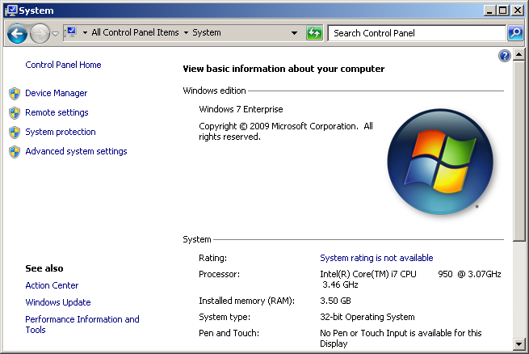
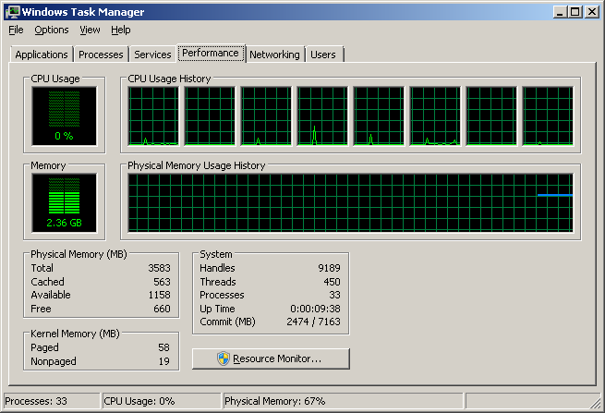
RAMDISK Benchmarks
Test system: Nehalem Core i7 950 and 4 GByte RAM
Software OS: WIN7 32-bit (max 4Gbyte RAM)
Setup: 2 GByte RAMDISKs from different software vendors
Hypothesis: RAMDISKs have different performance due to their implementations
License: All material, pictures can be freely reused with proper attribution (CC-by)
Author: Tobias Kind / FiehnLab 2009 / fiehnlab.ucdavis.edu

Slide 2
Used disk benchmark tools:
CrystalDiskMark
crystalmark.info
HDTach (trial)
www.simplisoftware.com
HDTune (trial)
www.hdtune.com
Atto
www.guru3d.com
Direct IO Disks - can be mounted as virtual disk and can be used with drive letter
- are not seen by Windows Disk Manager or HDTune/HDTach
- faster than direct disk mode (SCSI)
Comments: - Error may be as high as 20%;
- Older unsupported tools such as ATTO may have caching issues
- Direct IO is faster than direct disk mode
- Two test with two repeats, fastest result taken for table
- FAT and FAT32 and NTFS results mixed
See a collection of other HD benchmark tools at http://www.benchmarkhq.ru

Slide 3
Ramdisk performance results for Windows 7
A fast Ramdisk or ramdrive can deliver more than 5 GByte/sec seq. throughput
Good support and signed drivers are important; Backup option is important
Easy installation and de-installation as well as convenient GUI are a large plus
CPU penalty for Ramdisk use is one CPU core - due to RAMDISK and FS overhead
Commercial and free versions can be used (performance is not ultimate measure)

Slide 4
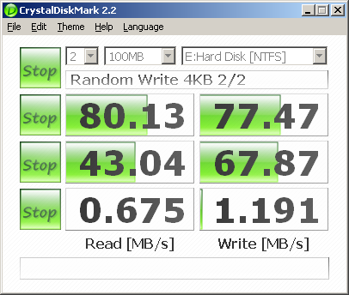
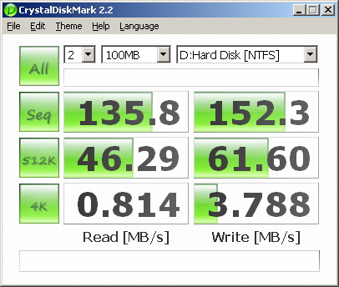
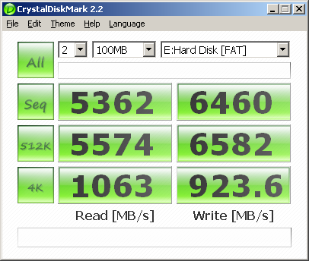
Benchmark of HDs vs. RamDisks vs. SSDs
Single HD
Seagate 750 GByte HD
ST3750528AS
RAID10 (Intel Matrix RAID)
WD RE3 750 GByte HD WD7502ABYS
Single RamDisk
QSOFT Ramdisk Enterprise
How about consumer SSDs? They can reach several hundred MByte/sec but not more.
IOPS for RAMDISKS: 30000-40000 @ 512 bytes and 4 kBytes
How about external or PCI-X based SSDs like Fusion IO? The can reach 1000 Mbyte/sec.
Cheapest DDR3 4Gbyte ~ 200 Dollars ; a 64 GByte RAMDISK would cost 3200 Dollar (4RAM)
A fast SSD or disk RAID array (RAID10 or RAID6) should be used for the production system
A small RAMDISK with few GBytes can be used when top performance is needed.
Using a RAMDISK has a penalty of one CPU core in use due to filesystem and ramdisk overhead.
Notes:
For Fusion-IO see http://stor-age.zdnet.com.cn/stor-age/2009/0724/1417331.shtml
Fusion IO (PCI-X) SSD:
512 bytes: 21117 IOPS 10 MB/s
4 kb 19807 IOPS 77 MB/s
64 kb 7074 IOPS 442 MB/s
1 MB 637 IOPS 637 MB/s
Random 1232 IOPS 615 MB/s
CrystalDiskMark
Sequential (Read/Write) 763.0 MB/s 620.6 MB/s
512k 725.2 MB/s 559.4 MB/s
4k 66.38 MB/s 77.11 MB/s
Source:
http://stor-age.zdnet.com.cn/stor-age/2009/0724/1417331.shtml

Slide 5
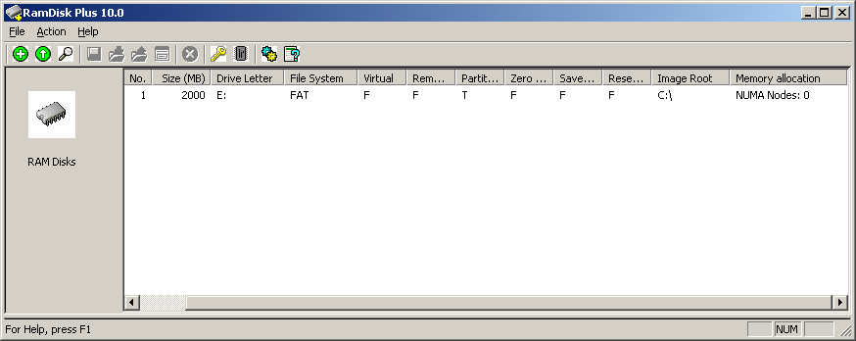
Product name: SuperSpeed RamDisk Plus / RamDisk
Product version: 10.0.1.0
Source: www.superspeed.com (trial)
Utility: Easy to use, no installation issues; single program with Backup;
WHQ certified no driver signature required
Price: RAMDISK plus 64-bit: 99 Dollar

Slide 6
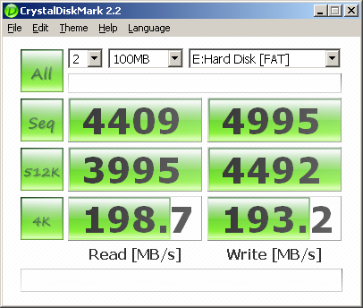
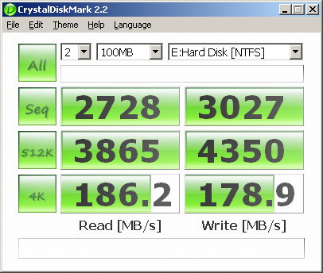
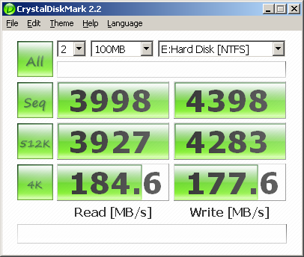
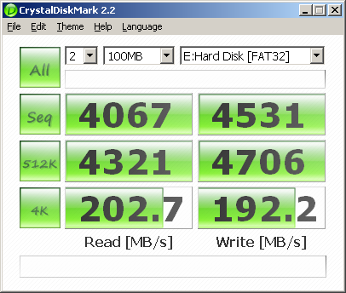
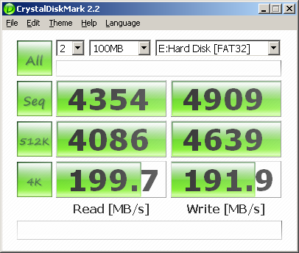
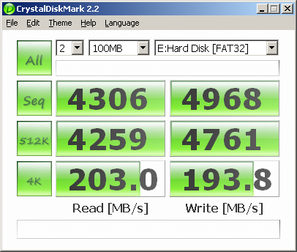
Product name: SuperSpeed RamDisk Plus / RamDisk
Product version: 10.0.1.0
Max CPU utilization (8 logic CPUs): 25%
FAT with 32 kByte units
NTFS with 4 kByte units
NTFS with 64 kByte units
FAT32 with 512 Byte units
FAT32 with 4 kByte units
FAT32 with 16 kByte units

Slide 7
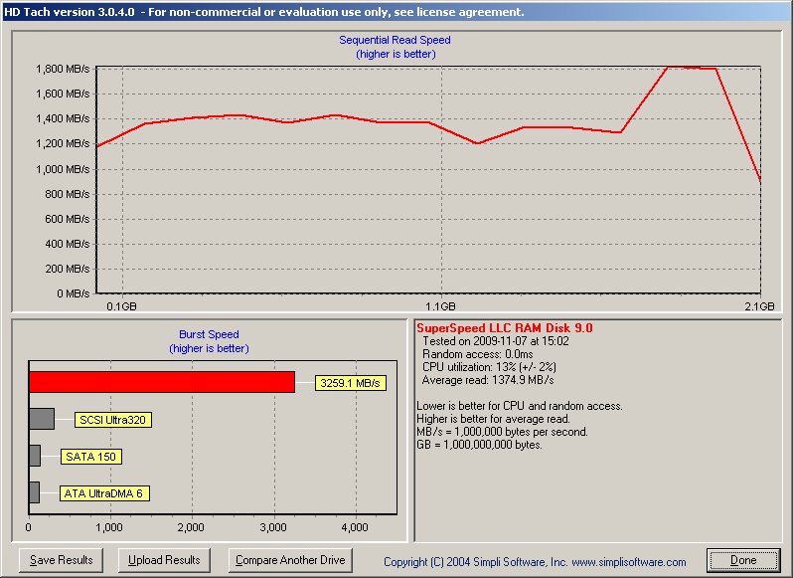
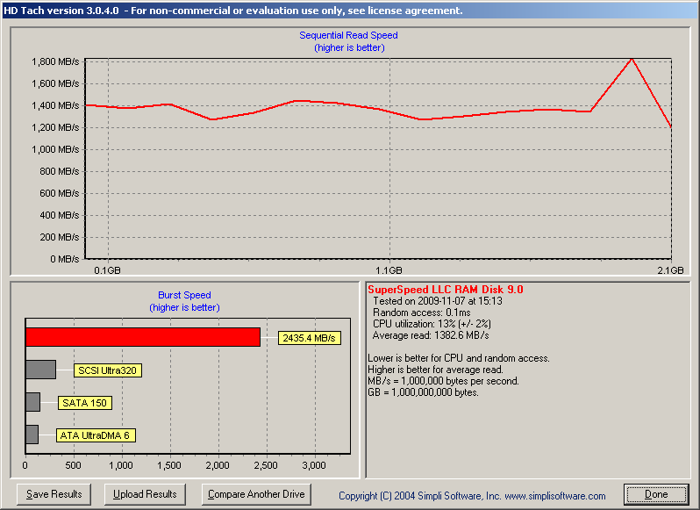
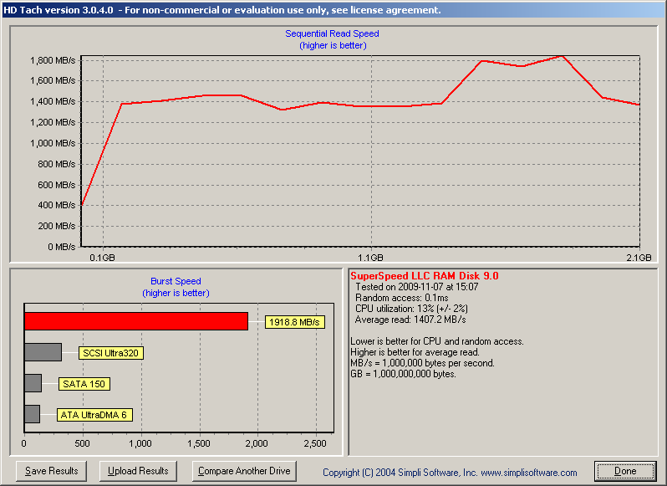
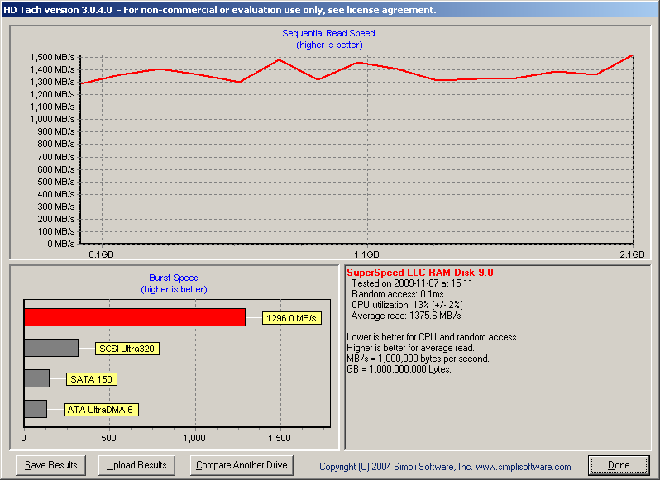
SuperSpeed RamDisk Plus with HDTACH READ (QuickBench 8 Mbyte Zones)
FAT - 32 kByte
FAT32 - 32 kByte
NTFS - 4 kByte
NTFS - 32 kByte

Slide 8
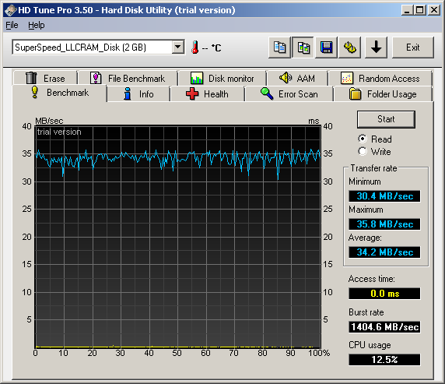
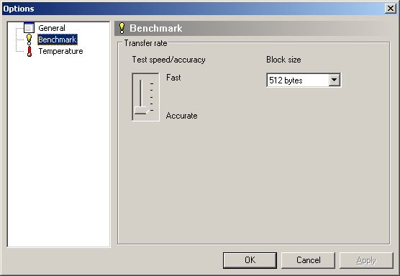
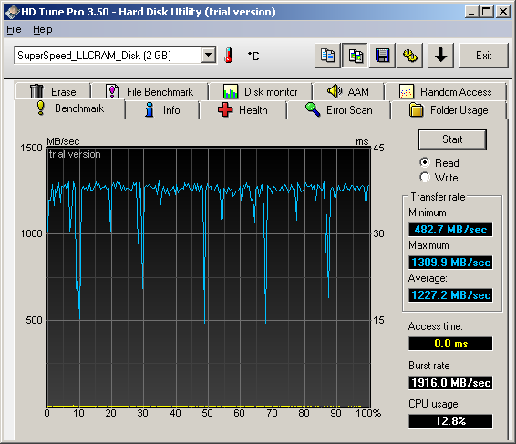
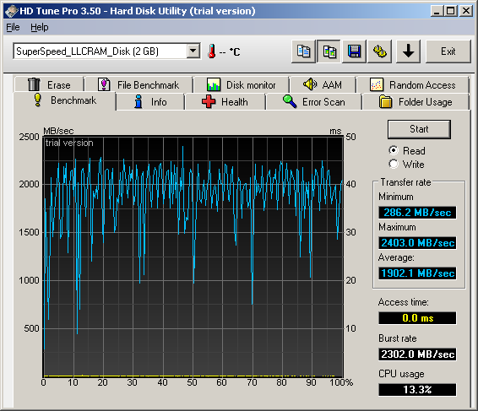
SuperSpeed RamDisk Plus
HDTune READ block size selection
512 byte
in HDTUNE
32 kbyte in HDTUNE
8 Mbyte in HDTUNE

Slide 9
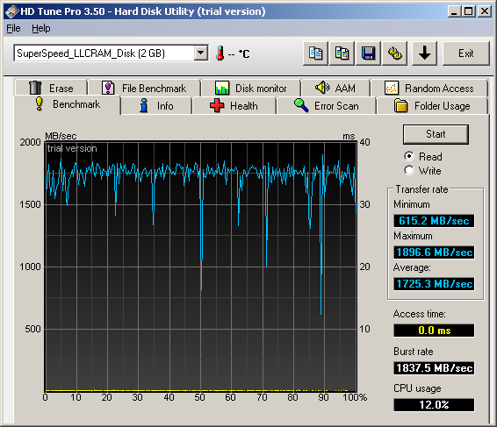
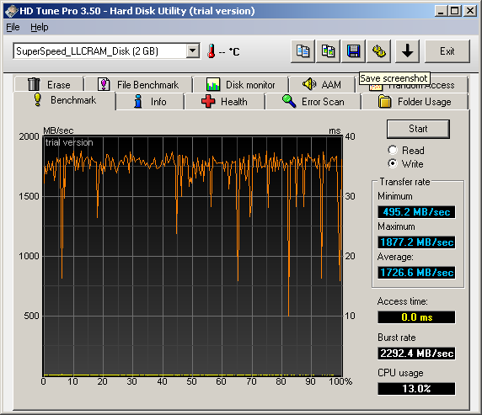
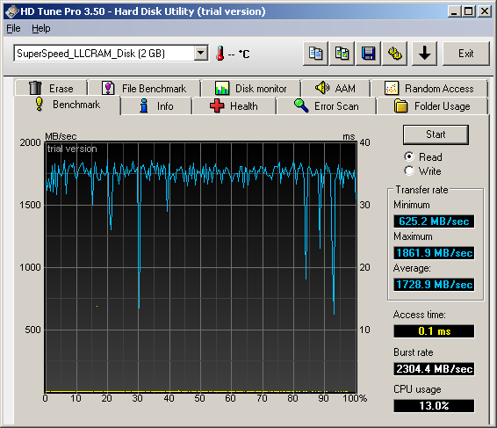
SuperSpeed RamDisk Plus
TEST with HDTune block size 64k
Read test
FAT32 - 4k
Write test
Read test - FAT 32k
Read test - NTFS - 4k

Slide 10
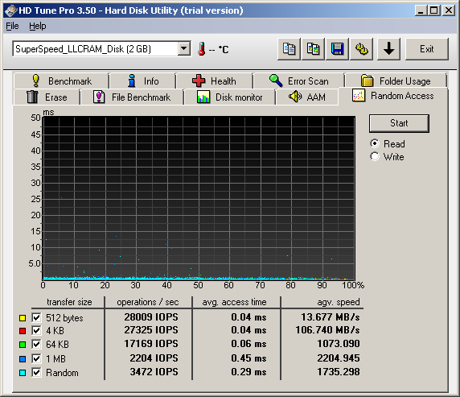
SuperSpeed RamDisk Plus
HDTune IOPS
IOPS Read
IOPS Write
Read/write performance: RAMDISK 28,174 IOPS @ 4K || SSDs have around 10k-20k @ 4k
Read/write performance: 2 GByte RAM = 30 Dollars → 933 IOPS per dollar @ 4k
Notes:
Fusion IO (PCI-X) SSD:
512 bytes: 21117 IOPS 10 MB/s
4 kb 19807 IOPS 77 MB/s
64 kb 7074 IOPS 442 MB/s
1 MB 637 IOPS 637 MB/s
Random 1232 IOPS 615 MB/s
CrystalDiskMark
Sequential (Read/Write) 763.0 MB/s 620.6 MB/s
512k 725.2 MB/s 559.4 MB/s
4k 66.38 MB/s 77.11 MB/s
Source:
http://stor-age.zdnet.com.cn/stor-age/2009/0724/1417331.shtml

Slide 11
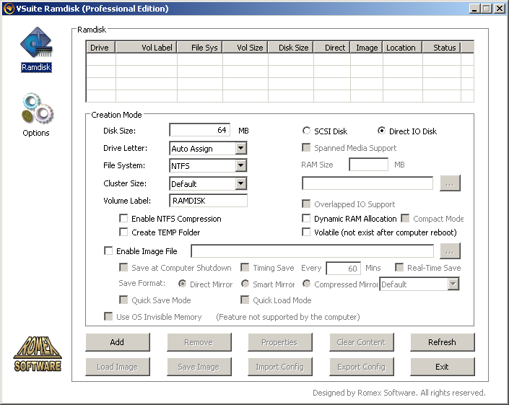
Product name: VSuite RamDisk
Product version: 4.1
Source: www.romexsoftware.com (trial and free version)
CN = SmartSource Shanghai Electronic Technology Co. Ltd
Utility: Easy to use, no installation issues; single program with Backup/Image file;
Self signed certificate; Direct IO and SCSI disk
Price: RAMDISK plus 64-bit: 99 Dollar and free version available

Slide 12
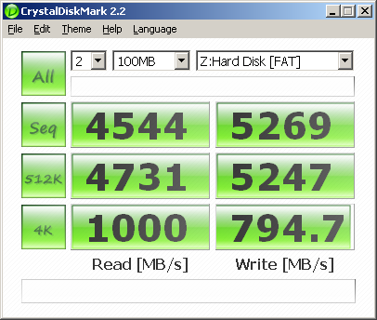
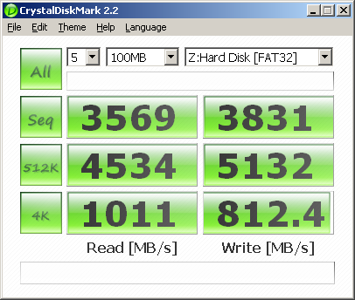
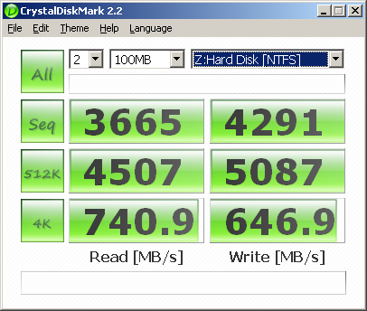
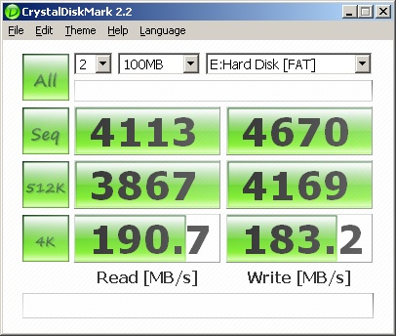
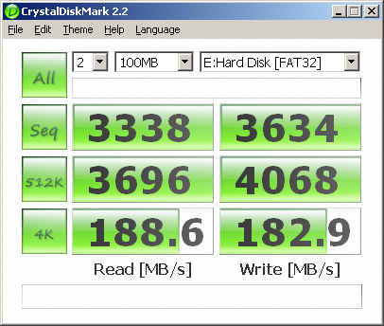
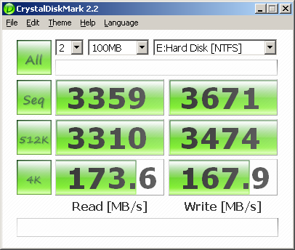
VSuite Ramdisk Professional; Direct IO and SCSI Disk
FAT formated (Direct IO)
FAT32 formated (Direct IO)
NTFS formated (Direct IO)
FAT formated (SCSI)
FAT32 formated (SCSI)
NTFS formated (SCSI)

Slide 13
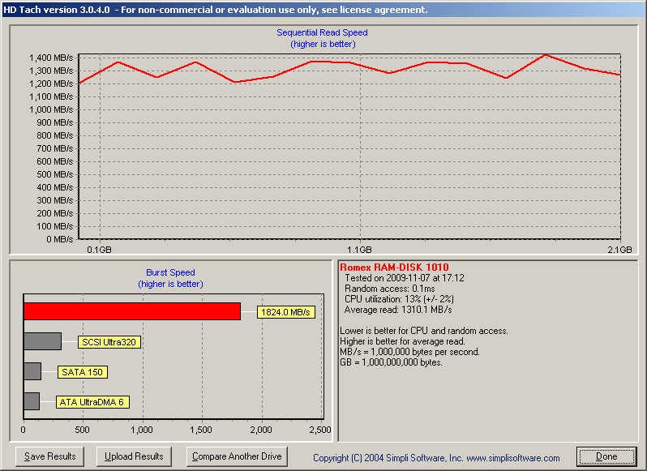
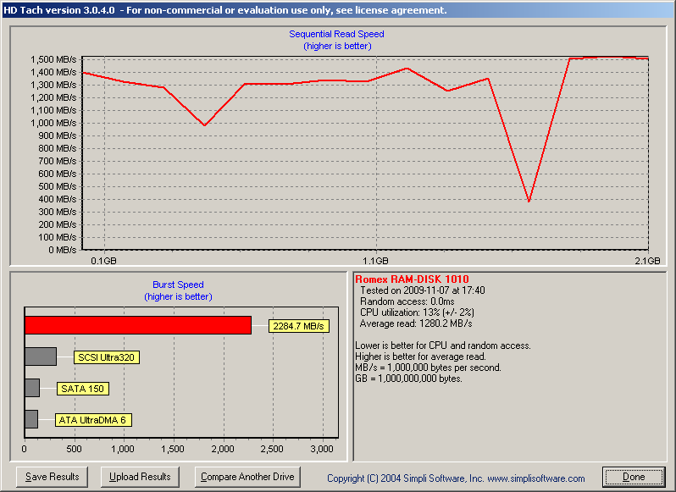
VSuite Ramdisk Professional; SCSI disk
NTFS
NTFS
FAT
FAT
FAT32
FAT32

Slide 14
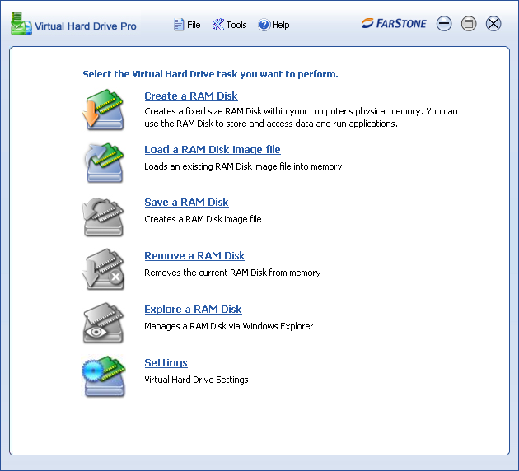
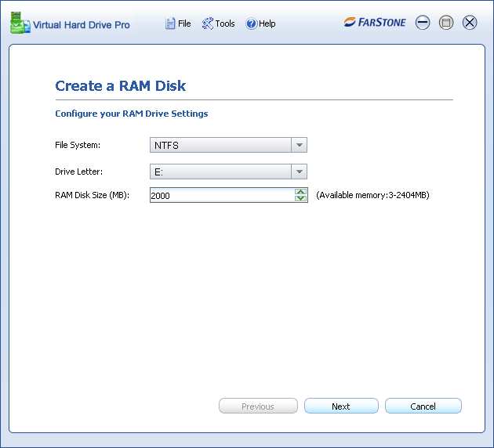
Product name: Virtual Hard Drive 2 Pro
Product version: 2.0
Source: http://www.farstone.com (trial version)
CN = Farstone Technology Inc
Utility: Easy to use, no installation issues; single program with Backup/Image file;
Self signed certificate; Requires Reboot; Direct IO (no HDTUNE/HDTACH)
Price: 29 Dollars

Slide 15
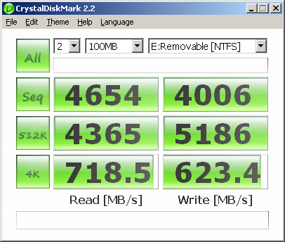
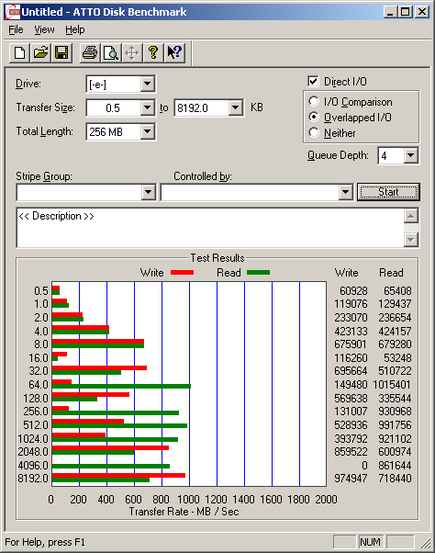
Product name: Virtual Hard Drive 2 Pro
Direct IO (no HDTUNE/HDTACH)

Slide 16
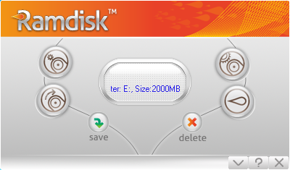
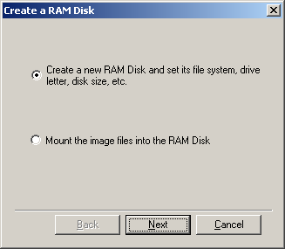
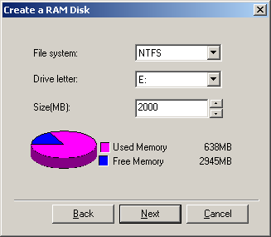
Product name: Gili Ramdisk
Product version: 3.2
Source: http://www.gilisoft.com (trial version)
CN = Pepstyle International Limited
Utility: Easy to use, no installation issues; single program with Backup/Image file;
No certificate; Direct IO (no HDTUNE/HDTACH)
Price: 25 Dollars

Slide 17
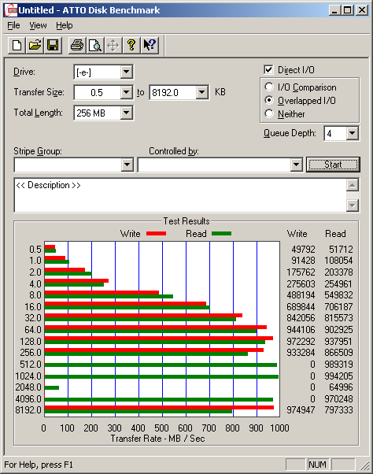
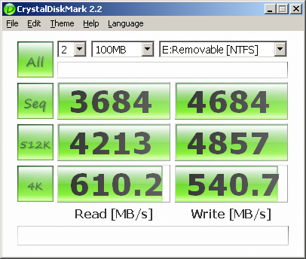
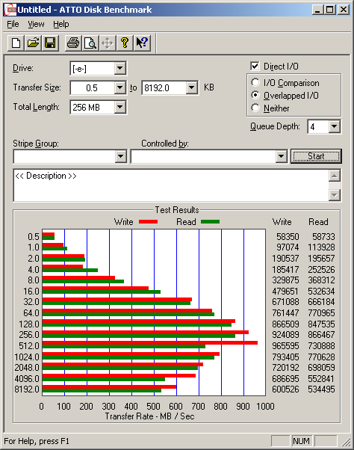
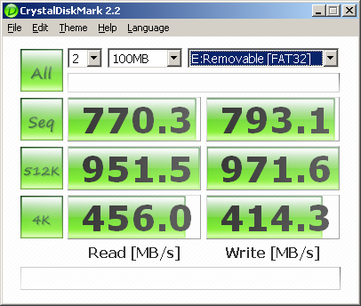
Product name: Gili Ramdisk
Direct IO (no HDTUNE/HDTACH)
NTFS
FAT32

Slide 18
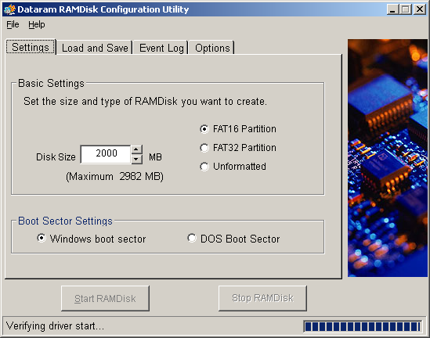
Product name: Cenatek Ramdisk (now Dataram)
Product version: V3.5
Source: http://memory.dataram.com (free version)
CN = Dataram; self signed
Utility: Easy to use, no installation issues; single program with Backup/Image file;
Self signed certificate;
Price: Free version; For larger than 4GByte free registration req.; PopUp to 18004memory.com

Slide 19
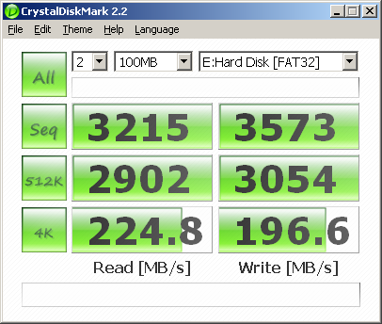
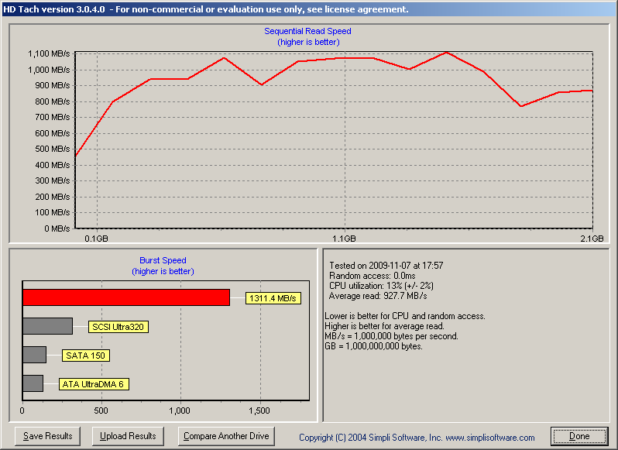
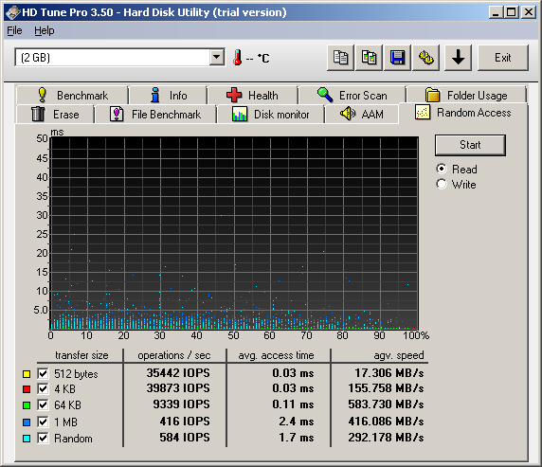
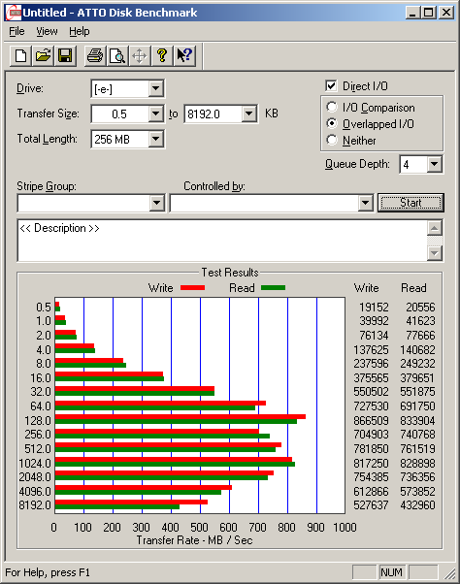
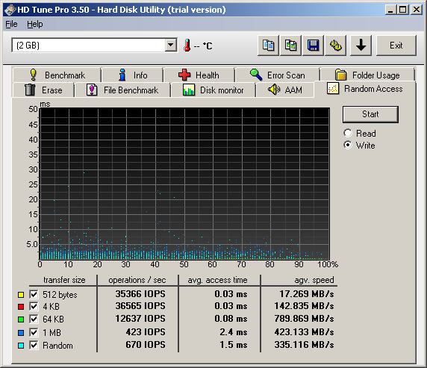
Product name: Cenatek Ramdisk (now Dataram)
FAT
FAT
Read IOPS
Write IOPS
ATTO NTFS

Slide 20
Product name: AR RAM Disk
Product version:
Source: http://www.arsoft-online.com
Utility: Easy to use; does not mount under WIN7
Price: free

Slide 21
Product name: Moio Systems Power RAMDisk
Product version: 2009.3.8. Power RAMDisk v2.80 (trial) Source: http://www.moiosystems.com/
Utility: Not signed, version 2.8 does not mount under WIN7; new version available (not tested)
Price: 10 Dollars

Slide 22
Product name: StarWind iSCSI
Product version: StarWind 4.0 (trial)
Source: www.starwindsoftware.com
CN- Rocket Division Software LTD
Utility: Use for net (TCPIP) access
Price: free or 395 Dollars (basic)
Problem: v4.0 does not mount under WIN7; new v5 available (not tested)

Slide 23
Product name: StarPort iSCSI Initiator
Product version: StarPort 3.6.3 (trial)
Source: www.starwindsoftware.com
Utility: Use for net (TCPIP) access, Maximum 1024 Mbyte; NTFS, FAT and FAT32
Price: Free for personal use

Slide 24
Product name: StarPort iSCSI Initiator

Slide 25
Product name: Cenatek RAMDISK XP
Product version: Any
Source: www.cenatek.com
Utility: Only runs under WINXP see Dataram (former Cenatek) version for WIN7
Price: Free for personal use (from Dataram, former Cenatek)

Slide 26
Product name: QSOFT Ramdisk Enterprise
Product version: 5.3.1.11 (trial)
Source: http://members.fortunecity.com/ramdisk
CN= Christiaan Ghijselinck
Access via device manager
Utility: Not easy to install; in WIN7 use hdwwiz ; however no installation issues
Self signed certificate; Direct IO (no HDTUNE/HDTACH)
Price: 25 Dollars (enterprise)

Slide 27
Product name: QSOFT Ramdisk Enterprise

Slide 28
Product name: ImDisk Virtual Disk Driver
Product version: 1.1.4
Source: http://www.ltr-data.se/opencode.html
Win7 Control Panel
Utility: Very hard to install and to remove; in WIN7 follow HOWTO (next page)
Direct IO (no HDTUNE/HDTACH)
Price: Free/open source

Slide 29
Product name: ImDisk Virtual Disk Driver
1) Explorer → Run as administrator
2) System →Start Imdisk Service
3) Control Panel
4) Install certificate
5) Open cmd as Administrator(!)
6) Enter at command line (thanks to dossi@bootland): imdisk.exe -a -t vm -m R: -o rw,fix,hd -s 1440M -p "/fs:ntfs /q /c /v:RAMDISK /y”
Notes:
Unmount:
C:\Windows\system32>imdisk -d -u 0
Flushing file buffers...
Locking volume...
R: Access is denied.
C:\Windows\system32>imdisk -d -u 1
Flushing file buffers...
Locking volume...
Dismounting filesystem...
Removing device...
Removing mountpoint...
OK.

Slide 30
Product name: ImDisk Virtual Disk Driver
Comment: To remove ImDisk type (use admin command): imdisk -d -u 0

Slide 31
Product name: ERAM for Windows
Product version: 2.20
Source: http://hp.vector.co.jp/authors/VA000363/index.htm
CN= Not available
Utility: No mount under WIN7; requires reboot;
Price: Free/open source

Slide 32
Product name: Everstrike DiskBoost for Windows Vista/XP/2003/2000
Product version: 2.0 (trial)
Source: http://www.everstrike.com/ramdisk
CN= Not available
Utility: Easy to install, current version not written for WIN7 (no drive actually mounted)
Price: 69 Dollar (business)

Slide 33
Product name: Gavotte Ramdisk
Product version: 01.01.2008
Source: http://www.chweng.idv.tw/swintro/ramdisk.php
Utility: Easy to install and to use; no certificate; run as Administrator for install
Price: free

Slide 34
Product name: RamPhantom 7
Product version: v7 free
Source: http://www.iodata.jp/
CN: IO Data
Utility: Install ok under WIN7; requires reboot; Free version 256 MB max
Price: 27 Dollar (Enterprise)

Slide 35
Product name: Microsoft DDK KMDF Ramdisk
Product version: WIN 2000
Source: http://msdn.microsoft.com/en-us/library/dd163312.aspx
http://support.microsoft.com/kb/257405
Utility: Ramdisk.sys sample driver for Windows 2000; No mount under WIN7;
in WIN7 use hdwwiz (Hardware Wizard)
Price: Free/open source

Slide 36
RAID of RAMDisks
(not recommended on production systems)
Mirrored Disks Windows
Striped Disks Windows
Spanned Disks Windows
Windows Disk Management
Windows Disk management allows striped, spanned, mirrored and RAID5 software disks Example with SuperSpeed driver (volumes visible in WIN7 Disk Manager )
Software RAID system is slower than single drive alone

